Slide 1
Hadoop Distributed File System

Slide 2
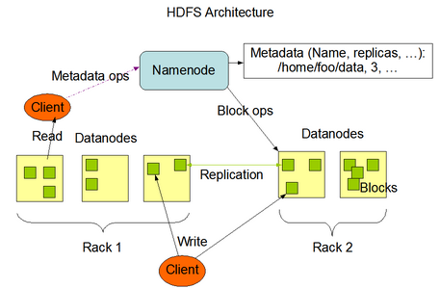
Hadoop Distributed File System
HDFS Overview
Hadoop Distributed File System is a distributed file system designed to run on commodity hardware.
Hierarchical UNIX-like file system for data storage
HDFS is highly fault-tolerant and is designed to be deployed on low-cost hardware
HDFS is designed for batch processing rather than interactive use by users. The emphasis is on high throughput of data access rather than low latency of data access.
Simple Coherency Model: HDFS applications need a write-once-read-many access model for files. A file once created, written, and closed need not be changed.
Splitting of large files into blocks (Default 64 MB)
Distribution and replication of blocks to nodes
Two key services
Master NameNode
Many DataNodes
Checkpoint Node (Secondary NameNode)
NameNode
Single master service for HDFS
Single point of failure (HDFS-1.x, Node High Availability in HDFS-2.x)
Stores file to block to location mappings in the namespaces
All transactions are logged to disk
NameNode startup reads namespace image and logs
Executes file system namespace operations like opening, closing,
and renaming files and directories.
NameNode determines the mapping of blocks to DataNodes.
DataNode
Stores blocks on local disk
Send frequent heartbeats to NameNode
Send block reports to NameNode
Clients connect to DataNode for I/O
DataNodes are responsible for serving read and write requests from the file system’s clients.
DataNodes perform block creation, deletion, and replication upon instruction from the NameNode

Slide 3
Secondary NameNode
Merge the FSImage and Edit log file periodically and keeps the edits log size within a limit
Not a hot backup
Checkpoint Name
Performs checkpoints of the NameNode’s namespace and logs
Not a hot backup
Loads up namespace
Reads log transactions (editLog) to modify namespace
Saves namespace as a checkpoint
Data Replication
Replication factor information is stored in NameNode
Blocks of a file are replicated for fault tolerance
All blocks in a file except the last block are the same size
Block size and replication factor are configurable per file
NameNode makes all decision regarding replication of blocks. It periodically receives a Heartbeat and a Blockreport from each of the DataNodes in the cluster
Block reports contains a list of all blocks on a DataNode
The purpose of a rack-aware replica placement policy is to improve data reliability, availability, and network bandwidth utilization.
Persistence of File System Metadata
HDFS namespace is stored by the NameNode.
NameNode uses a transaction log called the EditLog to persistently record every change that occurs to file system metadata. NameNode uses a file in its local host OS file system to store the EditLog.
The entire file system namespace, including the mapping of blocks to files and file system properties, is stored in a file called the FsImage. The FsImage is stored as a file in the NameNode’s local file system.
Space Reclamation
Deleted by user/ or an application
Move in “/trash” directory
A file remains in /trash for a configurable amount of time. After the expiry of its life in /trash, the NameNode deletes the file from the HDFS namespace.
A user can Undelete a file after deleting it as long as it remains in the /trash directory.
Decrease Replication Factor: When the replication factor of a file is reduced, the NameNode selects excess replicas that can be deleted. The next Heartbeat transfers this information to the DataNode. The DataNode then removes the corresponding blocks and the corresponding free space appears in the cluster.

Slide 4
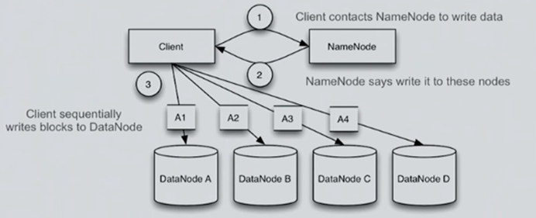
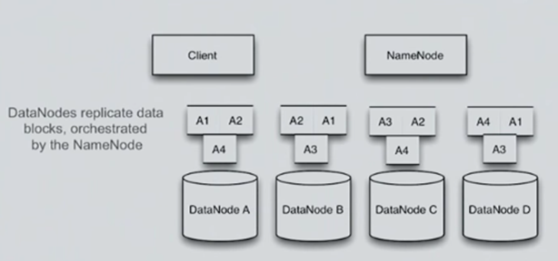
HDFS – Write
HDFS – Write Replication

Slide 5
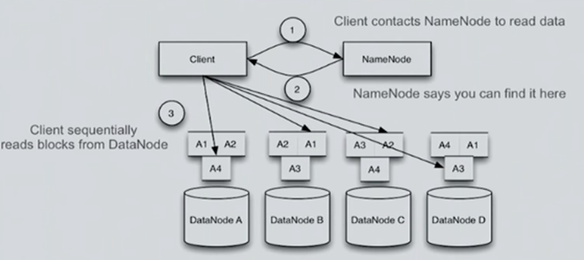
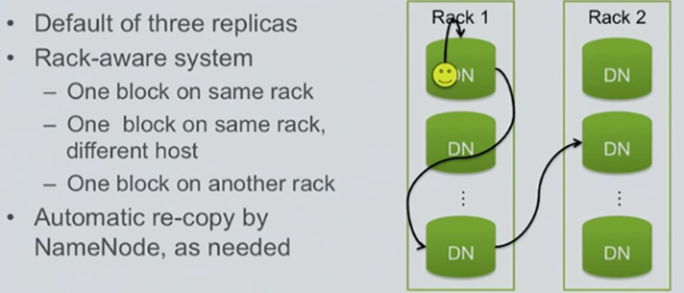
HDFS – Reads
HDFS – Block Replication

Slide 6
HDFS 2.0 Features
NameNode High-Availability (HA)
Two redundant NameNodes in active/passive configuration
Manual or automated failover
NameNode Federation
Multiple independent NameNodes using the same collection of DataNodes

Slide 7
Major HDFS Terms:
Safe Mode- NameNode
“fsck” command
“fetchdt” command → fetch delegation token
Balancer
Rack Awareness
Import Checkpoint
HFTP
Quotes – Name Quotes/ Space Quotes
Transparent Encryption in HDFS
HDFS Support for Multihomed Networks

